Slide 1
Storytelling Case Study : Airbnb, NYC Data Analysis Managers & Lead Data Analyst
Name : Swapnil Johri

Slide 2
Background
For the past few months, Airbnb has seen a major decline in revenue. Now that the restrictions have started lifting and people have started to travel more, Airbnb wants to make sure that it is fully prepared for this change.
The different leaders at Airbnb want to understand some important insights based on various attributes in the dataset so as to increase the revenue, such as –
Which type of hosts to acquire more and where?
What are the neighborhoods they need to target?
What is the pricing ranges preferred by customers?
The various kinds of properties that exist w.r.t. customer preferences.
Adjustments in the existing properties to make it more customer-oriented.
What are the most popular localities and properties in New York currently?
How to get unpopular properties more traction? and so on...

Slide 3
Proposed Solution
Our dataset is extensive, comprising numerous columns, each with varying potential to contribute to the decline in revenue. It's crucial to identify the primary factors influencing this downturn amidst the data noise.
We must prioritize analyzing the top variables that could be driving the revenue decline, delving deep into their impacts to uncover actionable insights for strategic decision-making.

Slide 4
Implementation

Slide 5
Implementation Measures
Data Gathering : Loading & Observing the past data provided by the Company
Data Cleaning : Duplicate removal, null value treatment, unnecessary column elimination, etc.
Performing EDA : Focus on different factors, & understand underlying pattern/trend through visualizations
Insights : Derive insights through created visualizations

Slide 6
Analysis & Insights

Slide 7
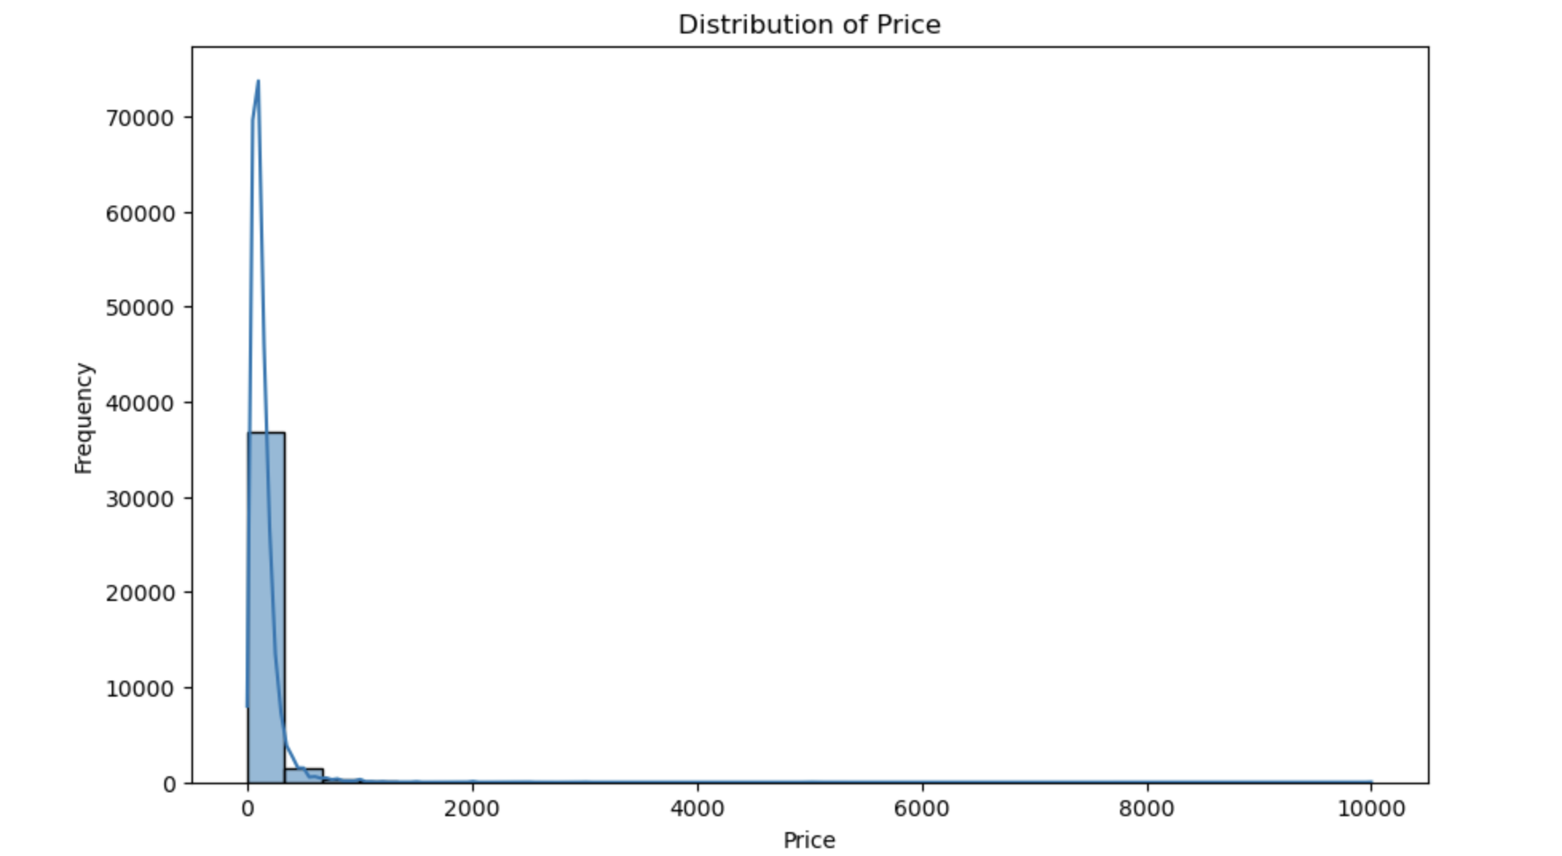
1. Price Distribution across all Properties
The major chunk of properties lies within the price range (0 – 1000]

Slide 8
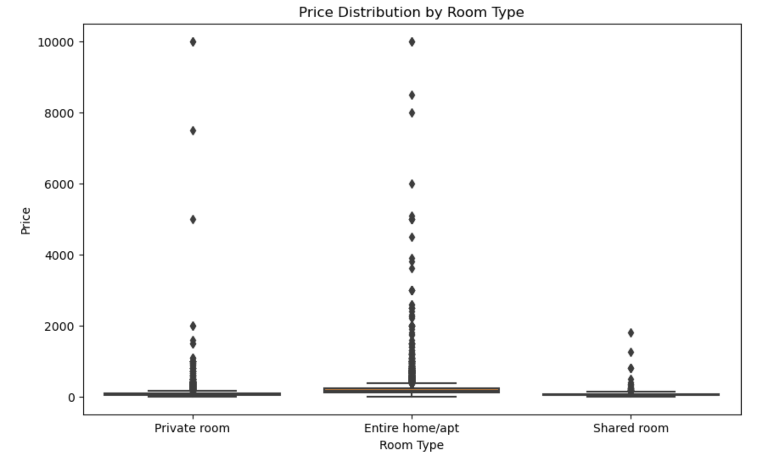
2. Price Distribution across Room Types

Slide 9
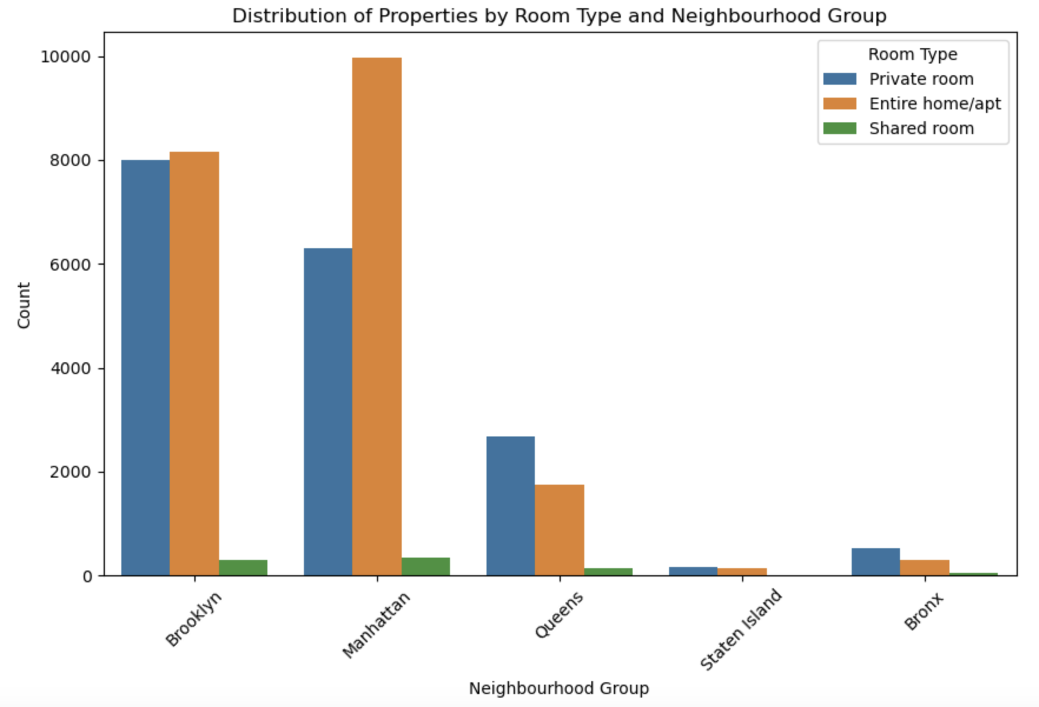
3. Understanding the distribution of properties by room type and neighborhood group
Over here, it’s visible that most of the properties being sold are in Brooklyn & Manhattan that too for room types Private & Entire home/apt

Slide 10
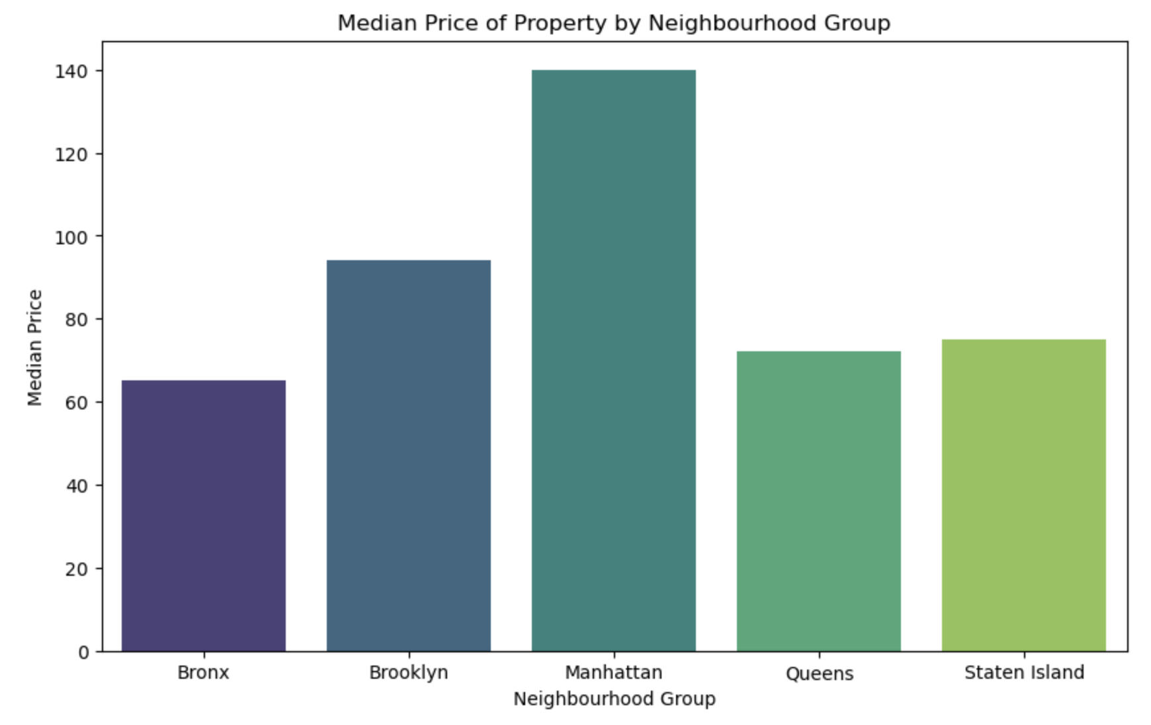
4. Median Price by Neighborhood Group
Graph shows that Manhattan has the most expensive properties listed

Slide 11
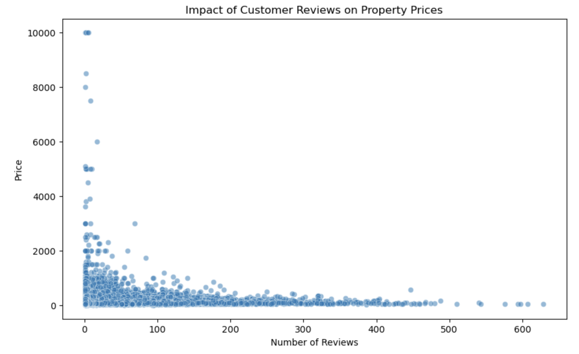
5. Evaluating the impact of customer reviews on property prices
Here, we see most of the less expensive properties are are mostly reviewed.

Slide 12
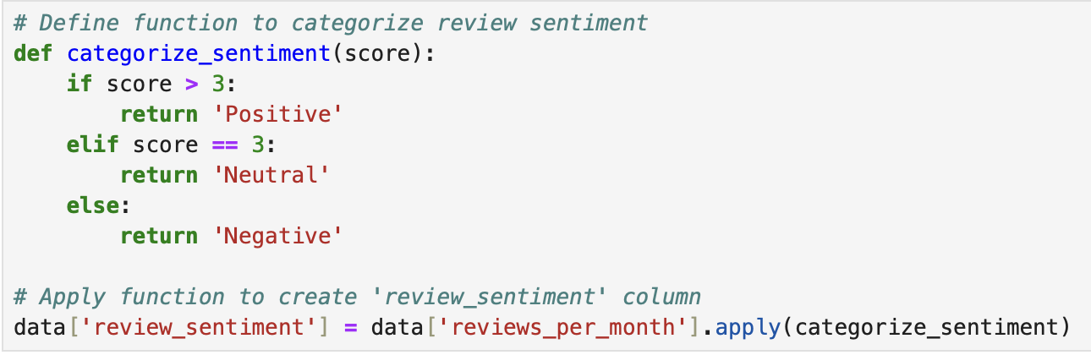
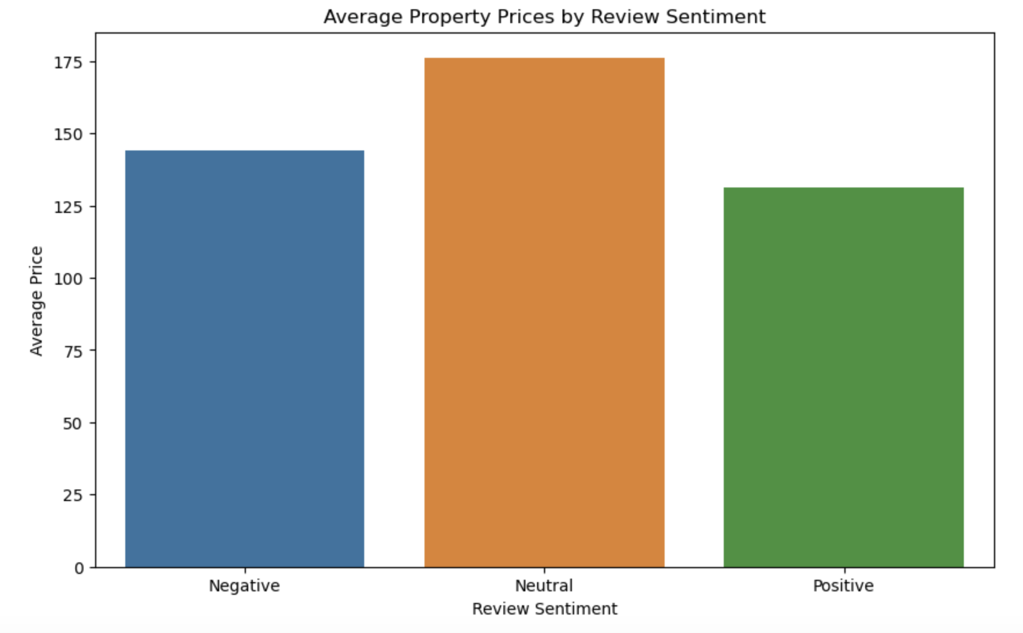
6. Property Prices by Review Sentiment
Here I created a column considering that if a property is being rated more than 3 times a month, it would mean that it has positive sentiment among the people, and it is less that 3; then it has a negative sentiment among people.
Later studying it v/s avg. price per night.

Slide 13
Recommendations For Decision Making Using Analysis Done

Slide 14
Recommendations
Categorizing customers based on their preferences for room types and neighborhoods.
Targeting specific neighborhoods with potential for growth.
Adjusting pricing strategies based on customer preferences and seasonal trends.
Improving underperforming properties by making them more customer-oriented.
Identifying and promoting unpopular properties through targeted marketing strategies.
Exploring opportunities to expand in popular localities like Manhattan.
Utilizing machine learning models to predict prices and optimize revenue.

Slide 15
Methodology Document

Slide 16
Methodology Document - 1
1. Data Loading and Preprocessing:**
- Loaded the dataset using Pandas.
- Converted the 'last_review' column to datetime format.
- Created a new column 'review_sentiment' to categorize review sentiment based on the number of reviews per month.
- Handled missing values by dropping rows with missing values.
2. Visualization of Price Distribution:
- Utilized a histogram to visualize the distribution of property prices.
- Plotted the histogram with 30 bins and kernel density estimation to show the frequency distribution of prices.
3. Relationship between Price and Room Type:
- Employed a box plot to analyze the relationship between property prices and room types.
- Grouped the data by room type and plotted the distribution of prices within each room type category.

Slide 17
Methodology Document - 2
4. Distribution of Properties by Room Type and Neighborhood Group:
- Utilized a count plot to understand the distribution of properties by room type and neighborhood group.
- Plotted the count of properties based on the combination of room type and neighborhood group, providing insights into the distribution of different property types across neighborhoods.
5. Types of Properties Preferred by Customers:
- Utilized a count plot to visualize the distribution of room types preferred by customers.
- Plotted the count of properties based on room type, identifying whether customers prefer entire homes/apartments, private rooms, or shared rooms.
6. Evaluating the Impact of Customer Reviews on Property Prices:
- Utilized a scatter plot to evaluate the impact of customer reviews on property prices.
- Plotted the number of reviews against property prices to analyze any correlation between the two variables.
7. Average Property Prices by Review Sentiment:
- Calculated the average property price for each category of review sentiment (positive, neutral, and negative).
- Utilized a bar plot to visualize the average property prices by review sentiment, providing insights into how customer reviews sentiment affects property prices.
# This methodology document outlines the steps undertaken for data analysis and visualization, providing insights into various aspects of the dataset related to property prices, room types, neighborhood distribution, and customer reviews sentiment. Each visualization serves to provide valuable insights for stakeholders and decision-makers at Airbnb.

